Slide 1


Artificial Neural Networks
 | AICTE-QIP-PG Certificate Programme on Machine Learning at IIIT-Surat
Dr. Sudeep Sharma
IIIT Surat
sudeep.sharma@iiitsurat.ac.in

Slide 2
Activation Functions
Model of an artificial neuron
x₁
x₂
Σ
f(.)
y_{k}
x₃
x_{n}
b_{k}
Fig: ​Typical Neuron Model having Activation Function
Source: Google Images

Slide 3
Activation Functions
About Activation Functions:
The Activation Function is applied to the output of a neuron.
The Activation Function modifies the neuron output.
We use Activation Functions to introduce nonlinearity or desired mapping in the model.
In general, neural networks use two types of activation functions.
The first will be the activation function used in hidden layers, and the second will be used in the output layer.

Slide 4
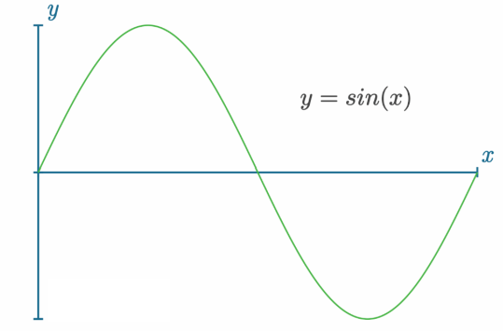
Activation Functions
Why Use Activation Functions?
What is a nonlinear function?
A nonlinear function cannot be represented well by a straight line, such as a sine function:
Fig: ​ Graph of y=sin(x)
Source: Google Images

Slide 5
Activation Functions
Why Use Activation Functions?
As most of the problems of our time are nonlinear.
Example: The price of a home (various factors like: size, location, number of rooms, yard, neighborhood, and so on, makes the problem nonlinear)
In most cases, for a neural network to fit a nonlinear function.
We need it to contain two or more hidden layers.
We need those hidden layers to use the nonlinear activation functions.

Slide 6
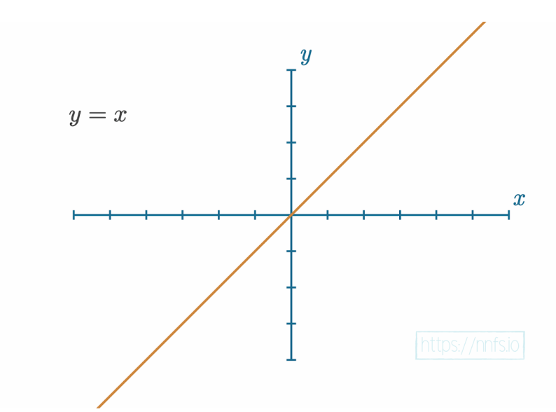
Activation Functions
The Linear Activation Function
This activation function is usually applied to the last layer’s output in the case of a regression model.
Fig: ​ Linear function graph.
Source: Google Images

Slide 7
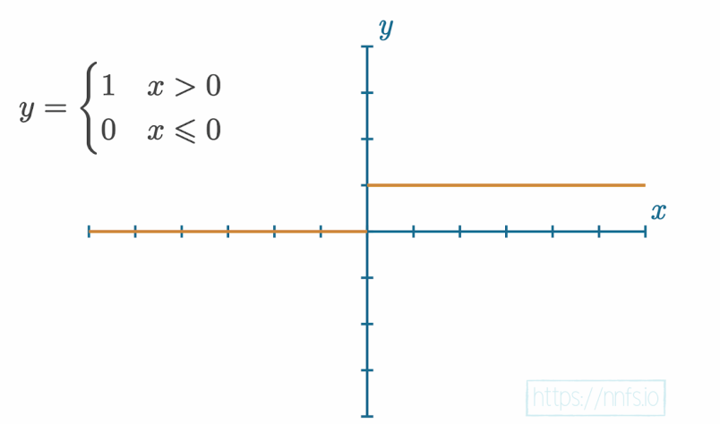
Activation Functions
The Step Activation Function:
A neuron “firing” or “not firing”
This activation function has been used historically in hidden layers, but nowadays, it is rarely a choice.
Fig: ​ Step function graph.
Source: Google Images

Slide 8
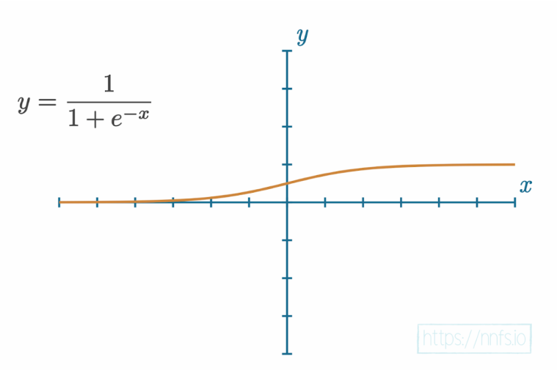
Activation Functions
The Sigmoid Activation Function
The problem with the step function is it’s not very informative. It’s hard to tell how “close” this step function was to activating or deactivating.
The output from the Sigmoid function, being in the range of 0 to 1, the returned value contains all the information from the input. The Sigmoid function, historically used in hidden layers, was eventually replaced by the ​Rectified Linear Units ​ activation function or ​ReLU.
Fig: ​ Sigmoid function graph.
Source: Google Images

Slide 9
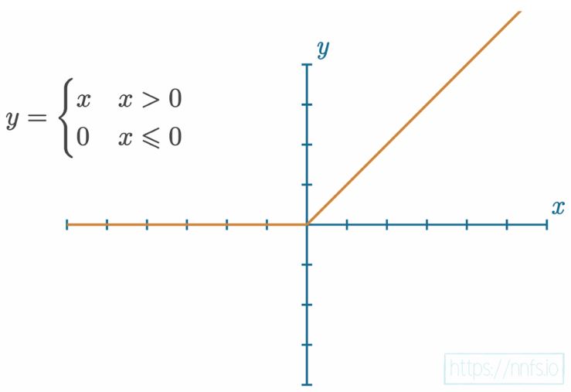
Activation Functions
The Rectified Linear Activation Function
The rectified linear activation function is simpler than the sigmoid. This simple yet powerful activation function is the most widely used activation function, mainly due to speed and efficiency.
Fig: ​ Graph of the ReLU activation function
Source: Google Images

Slide 10
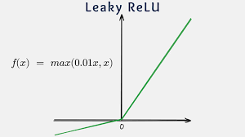
Activation Functions
The Leaky Rectified Linear Activation Function
Fig: ​ Graph of the Leaky ReLU activation function
Source: Google Images

Slide 11
Activation Functions
The Softmax Activation Function
For a classification problem, we want an activation function meant for classification.
The Softmax activation function is used for that purpose.
In the case of classification, what we want to see is a prediction of which class the network “thinks” the input represents.
Softmax activation function represents ​confidence scores ​ for each class and will add up to 1.
The predicted class is associated with the output neuron that returned the largest confidence score.

Slide 12
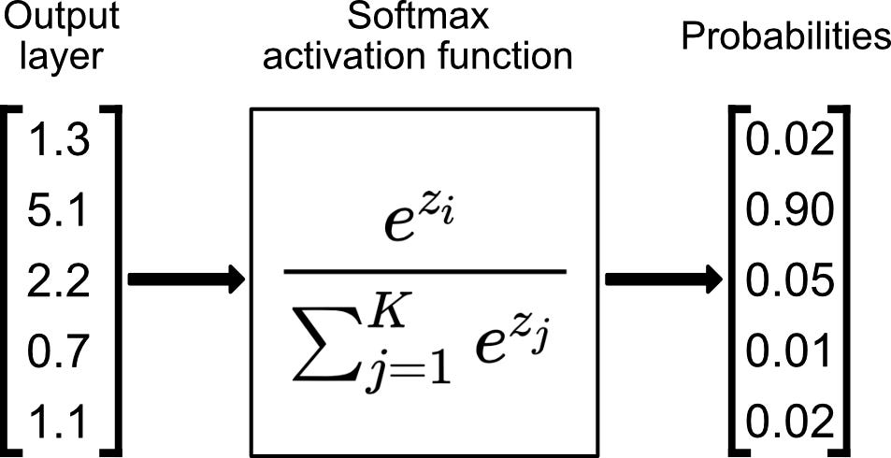
Activation Functions
The Softmax Activation Function
Source: Google Images

Slide 13
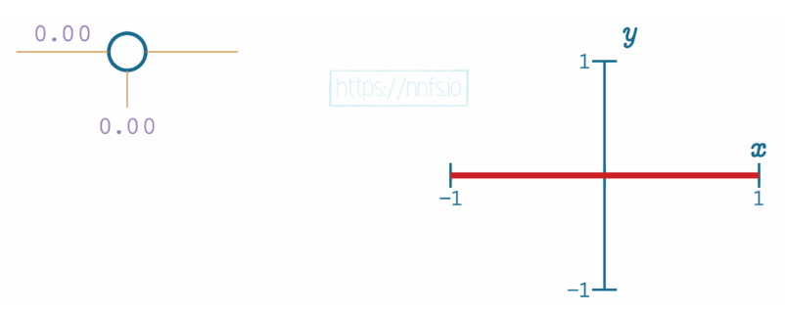
Activation Functions
ReLU Activation with a single Neuron
Fig: ​ Single neuron with single input (zeroed weight) and ReLU activation function

Slide 14
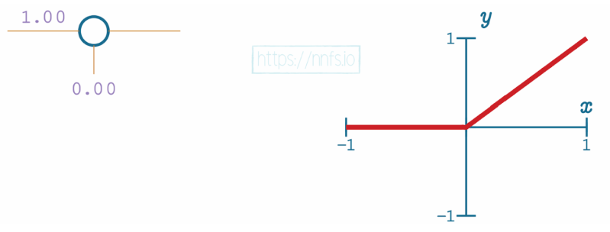
Activation Functions
ReLU Activation with a single Neuron
Fig: ​ Single neuron with single input and ReLU activation function, weight set to 1.0.
Source: Google Images

Slide 15
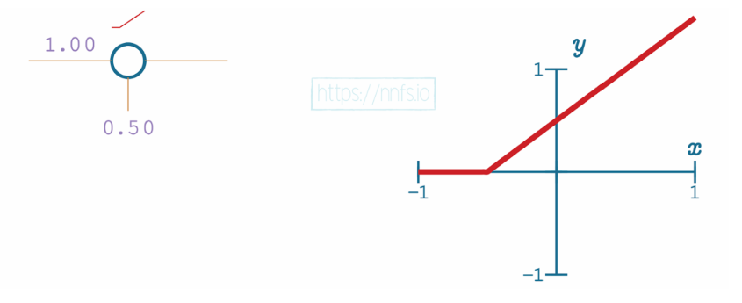
Activation Functions
ReLU Activation with a single Neuron
Fig: ​ Single neuron with single input and ReLU activation function, negative weight.
Source: Google Images

Slide 16
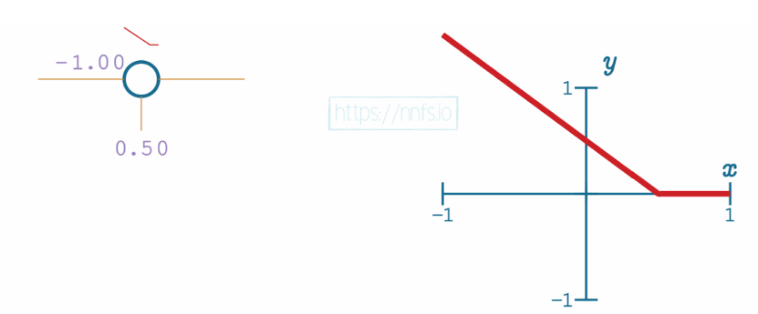
Activation Functions
ReLU Activation with a single Neuron
Fig: ​ Single neuron with single input and ReLU activation function, bias applied.
Source: Google Images

Slide 17
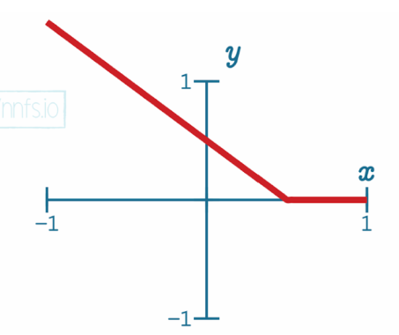
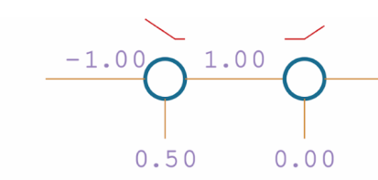
Activation Functions
ReLU Activation in a Pair of Neurons
Fig: ​ Pair of neurons with single inputs and ReLU activation functions.
Source: Google Images

Slide 18
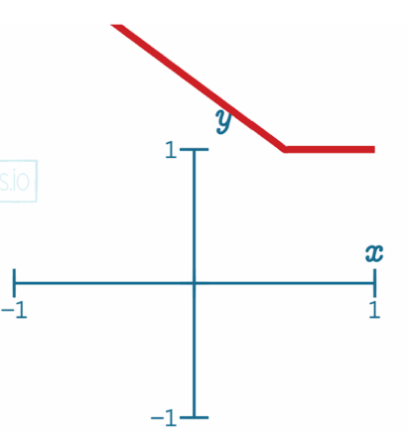
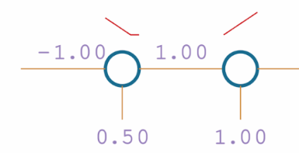
Activation Functions
ReLU Activation in a Pair of Neurons
Fig: ​ Pair of neurons with single inputs and ReLU activation functions, other bias applied.
Source: Google Images

Slide 19
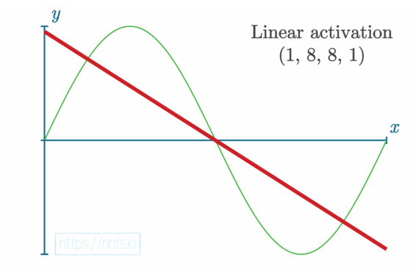
Activation Functions
Why Use Activation Functions?
Source: Google Images

Slide 20
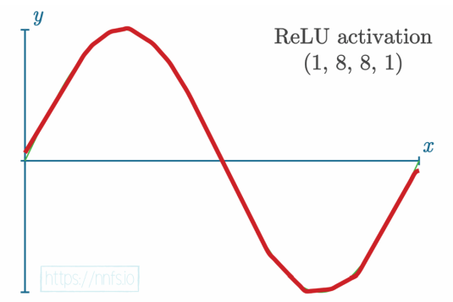
Activation Functions
Why Use Activation Functions?
Source: Google Images

Slide 21
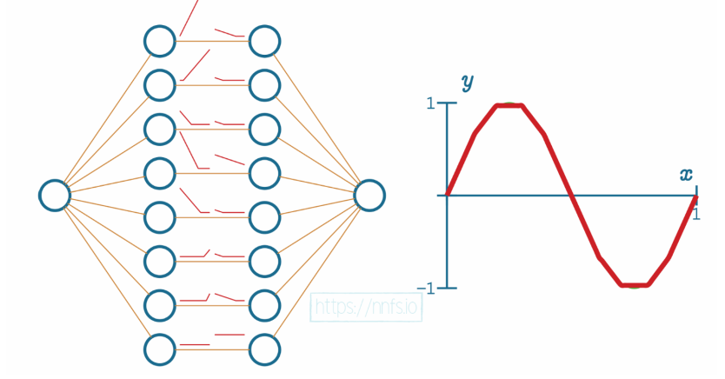
Activation Functions
ReLU Activation in the Hidden Layers
Fig : ​ The simple mapping process to fit sin(x) function
Source: Google Images

Slide 22
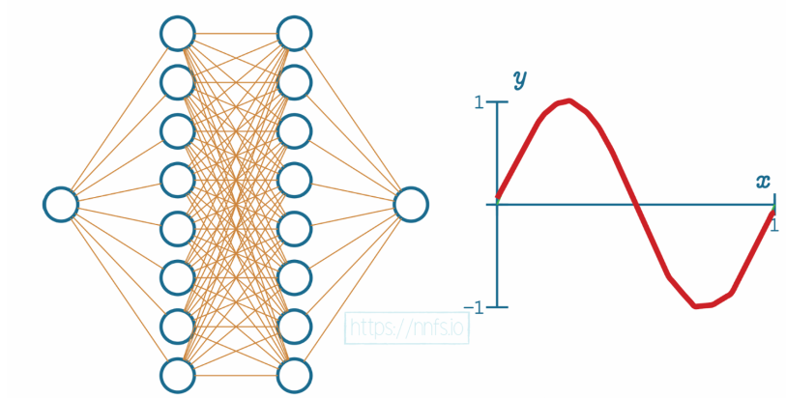
Activation Functions
ReLU Activation in the Hidden Layers
Fig : ​ Example of fitment after fully-connecting the neurons and using an optimizer.
Source: Google Images

Slide 23
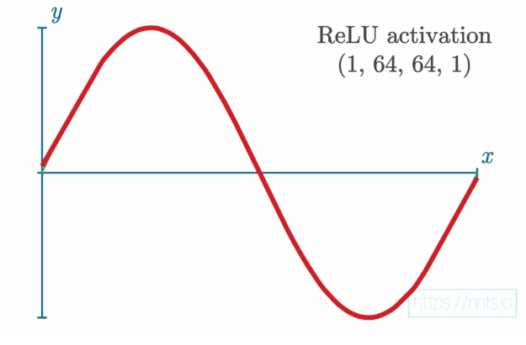
Activation Functions
ReLU Activation in the Hidden Layers
Fig : ​ Fitment with 2 hidden layers of 64 neurons each, fully connected, with optimizer.

Slide 24
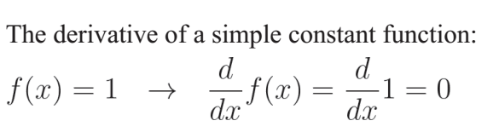
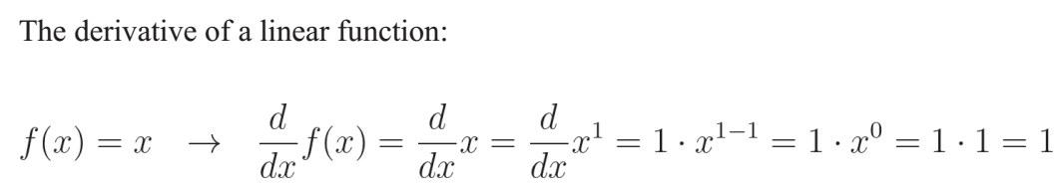
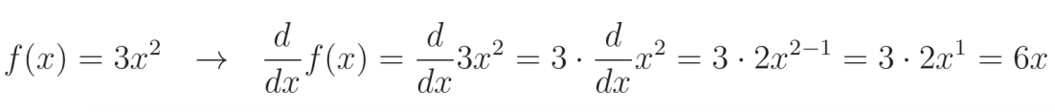
Impact of Parameter on the Output
Derivatives

Slide 25
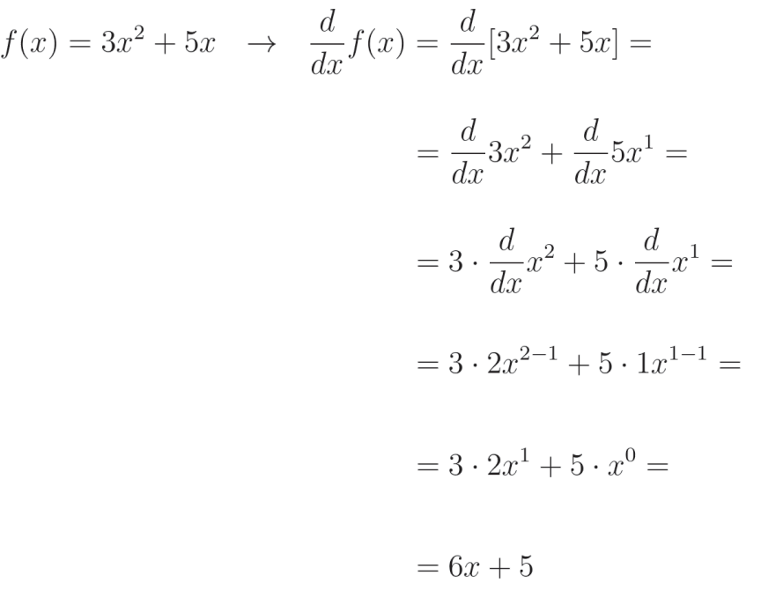
Impact of Parameter on the Output
Derivatives

Slide 26
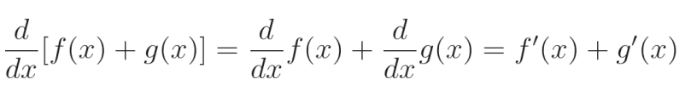
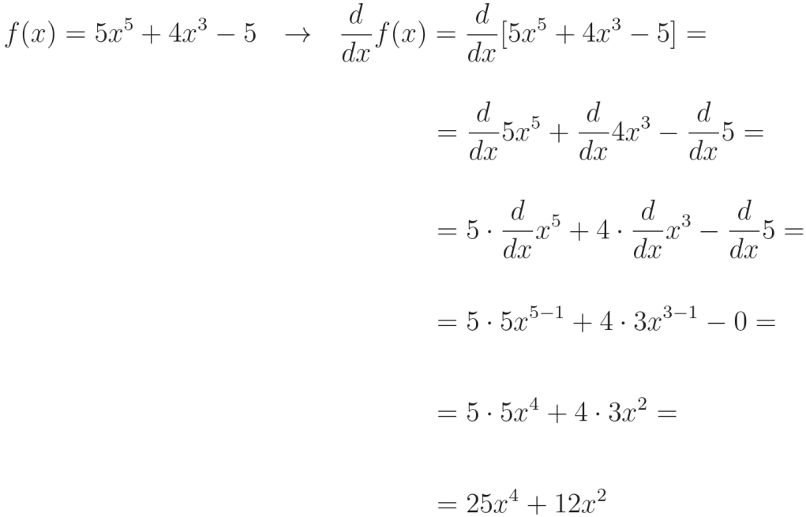
Impact of Parameter on the Output
Derivatives

Slide 27
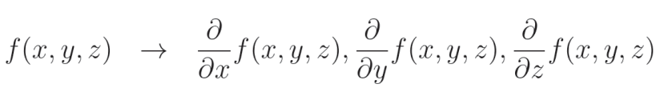
Impact of Parameter on the Output
Partial Derivatives
The ​partial derivative ​ measures how much impact a single parameter has on the function’s output.
The ∂ operator means explicitly the partial derivative.

Slide 28
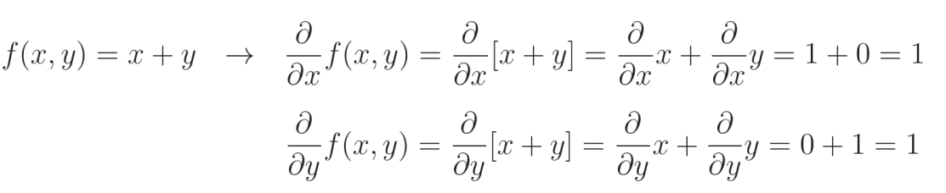
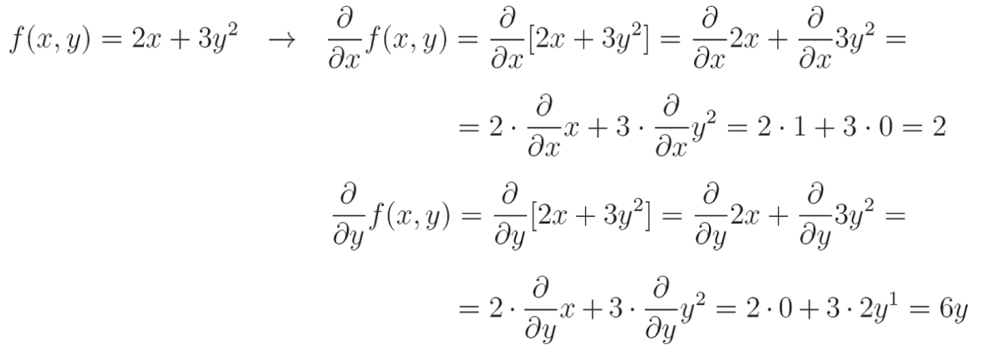
Impact of Parameter on the Output
Partial Derivatives
The Partial Derivative of a Sum

Slide 29

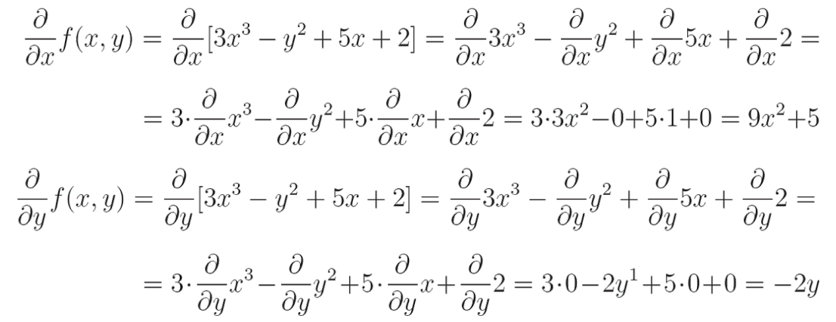
Impact of Parameter on the Output
Partial Derivatives
The Partial Derivative of a Sum

Slide 30

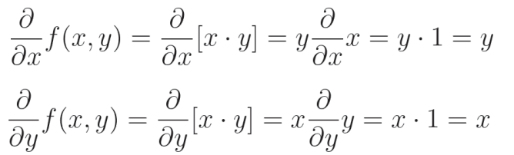
Impact of Parameter on the Output
Partial Derivatives
The Partial Derivative of Multiplication

Slide 31

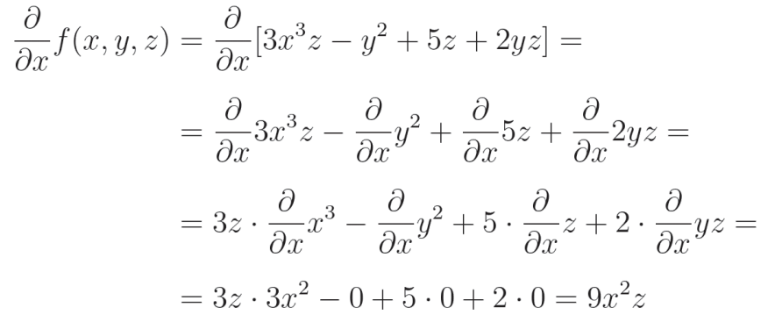
Impact of Parameter on the Output
Partial Derivatives
The Partial Derivative of Multiplication

Slide 32
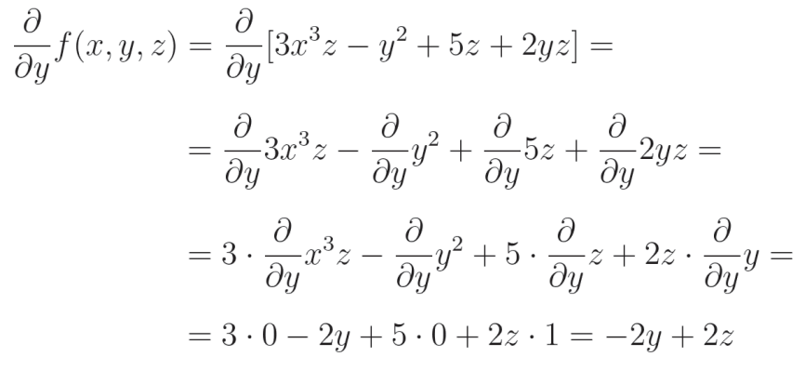
Impact of Parameter on the Output
Partial Derivatives
The Partial Derivative of Multiplication

Slide 33
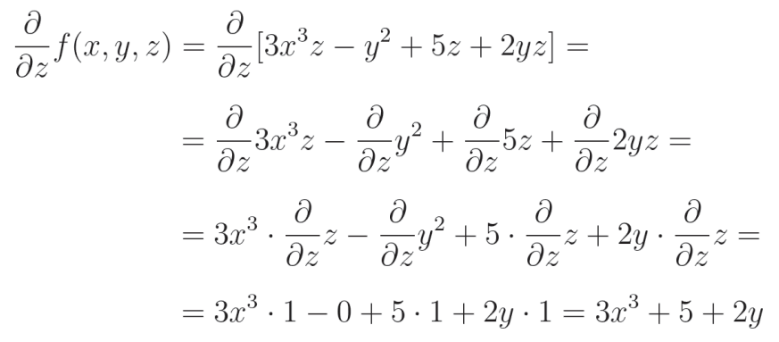
Impact of Parameter on the Output
Partial Derivatives
The Partial Derivative of Multiplication

Slide 34



Impact of Parameter on the Output
Partial Derivatives
The Partial Derivative of ​Max

Slide 35

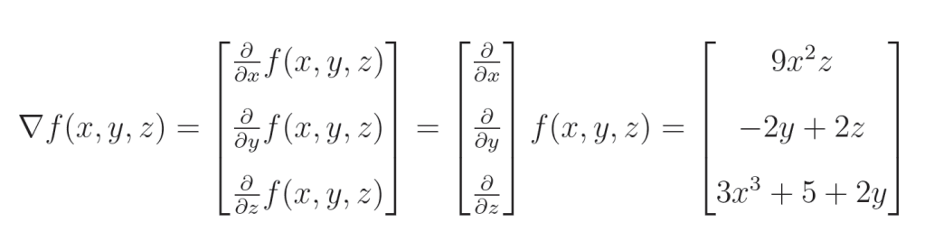
Impact of Parameter on the Output
The Gradient
The gradient is a ​vector ​composed of all the partial derivatives of a function:

Slide 36



Impact of Parameter on the Output
The Chain Rule
The chain of functions:

Slide 37
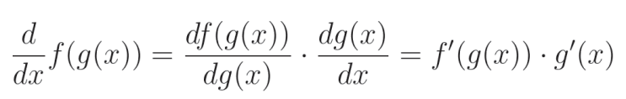
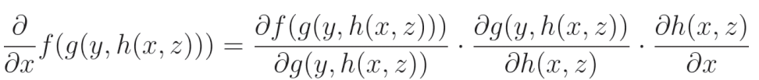
Impact of Parameter on the Output
The Chain Rule
Consider a chain of functions:

